Slide 1
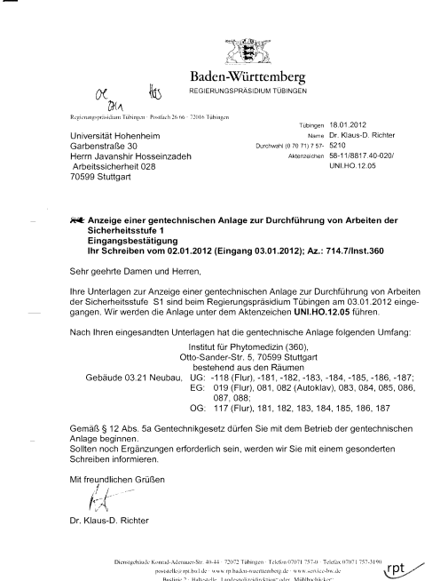
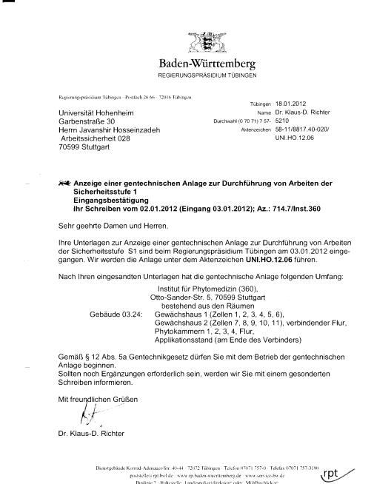
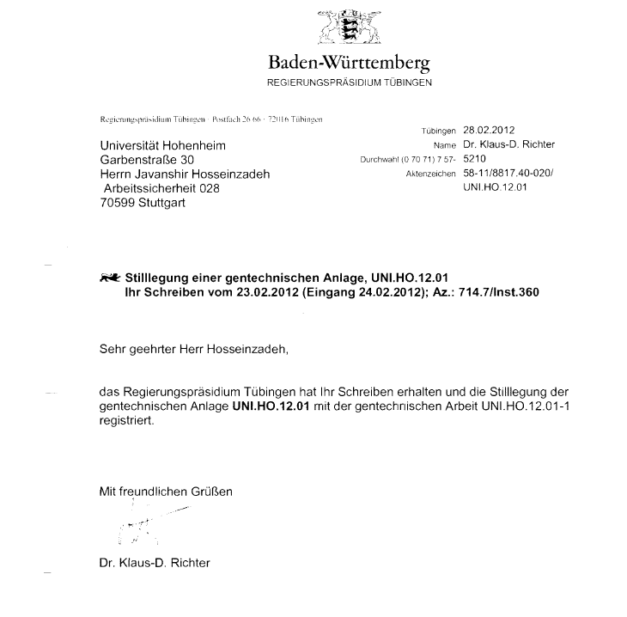
Institute-Specific Safety Instruction for work with Genetically Modified Organisms (GMOs) at Containment Level S1 according to §12 (3) GenTSV
08.12.2025
The following rooms are considered part of the genetically modified organism (GMO) facilities/laboratories. All work with genetically modified organisms at level S1 must be conducted exclusively within these designated areas:

Slide 2
Overview
Laboratory and Greenhouse Structure Overview of the laboratory and greenhouse layout, designated work areas, and access restrictions.
Safety and Handling Rules for Genetically Modified Organisms
Working with Genetically Modified Organisms
Guidelines for Handling Transgenic Plants
Disposal of Genetically Engineered Waste
Procedures in Case of Emergency or Accident
What to do in an emergency or fire
Handling Accidents with S1 Organisms
Records of Genetic Engineering Work Documentation requirements for experiments with GMOs.
Operating Instructions

Slide 3
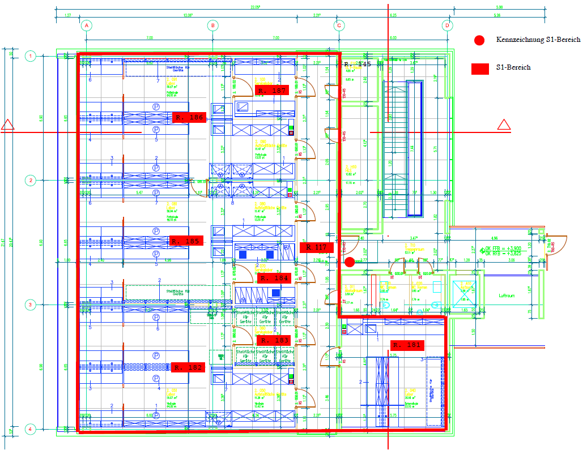
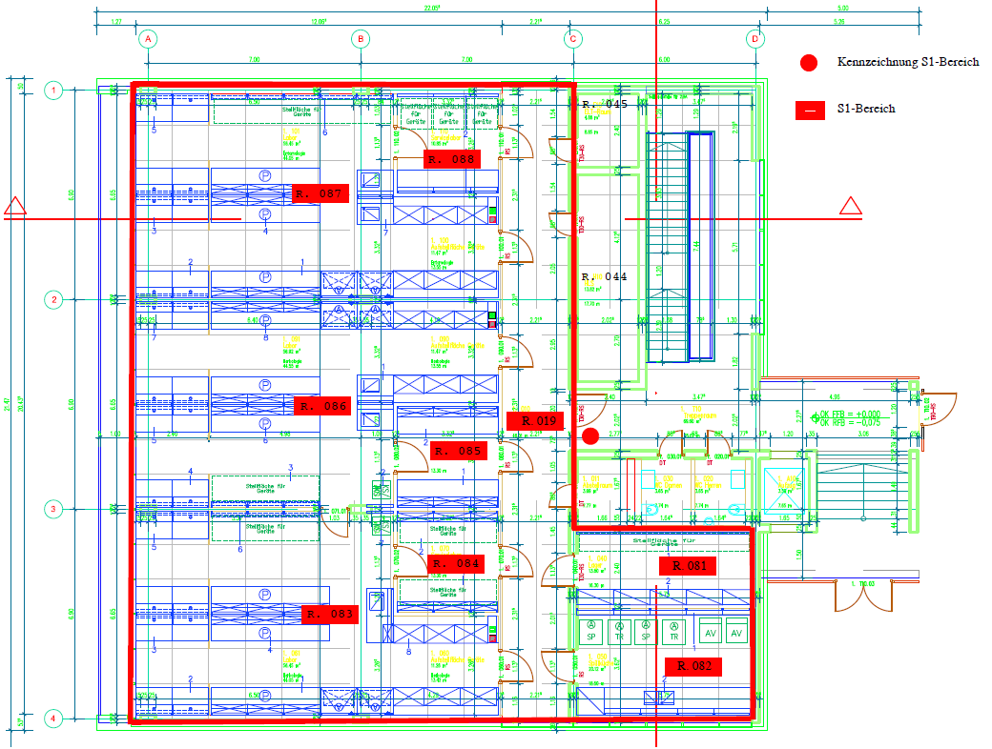
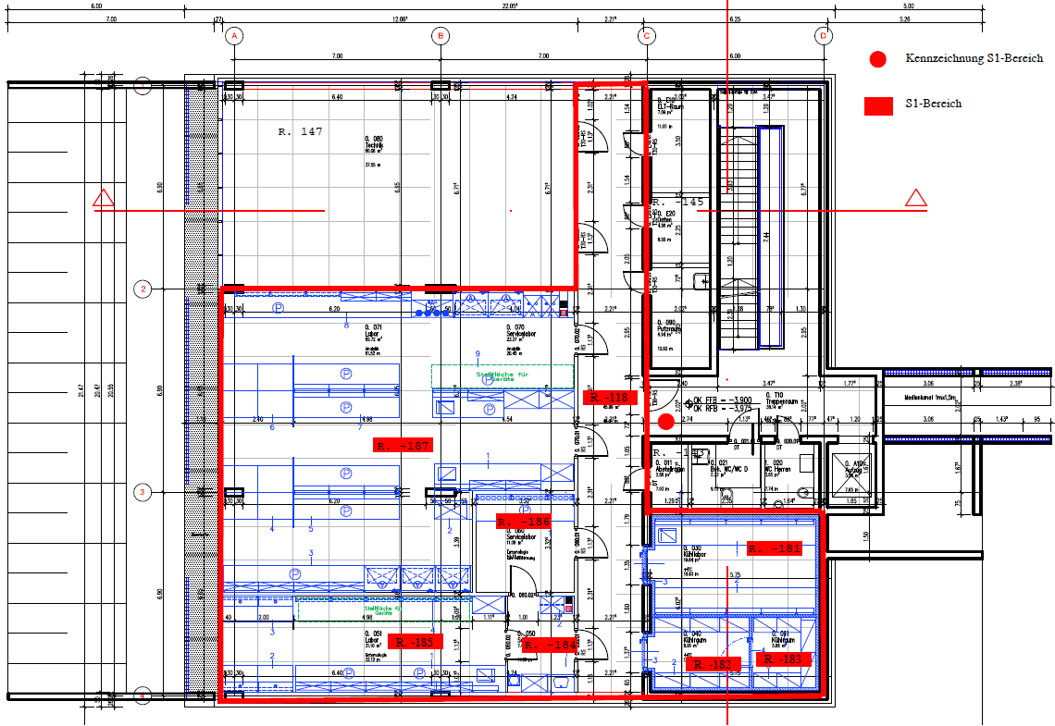
Laboratory Structure
Red-outlined area is the S1 area.
Upper floor
Ground floor
Basement floor

Slide 4
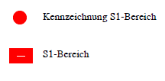
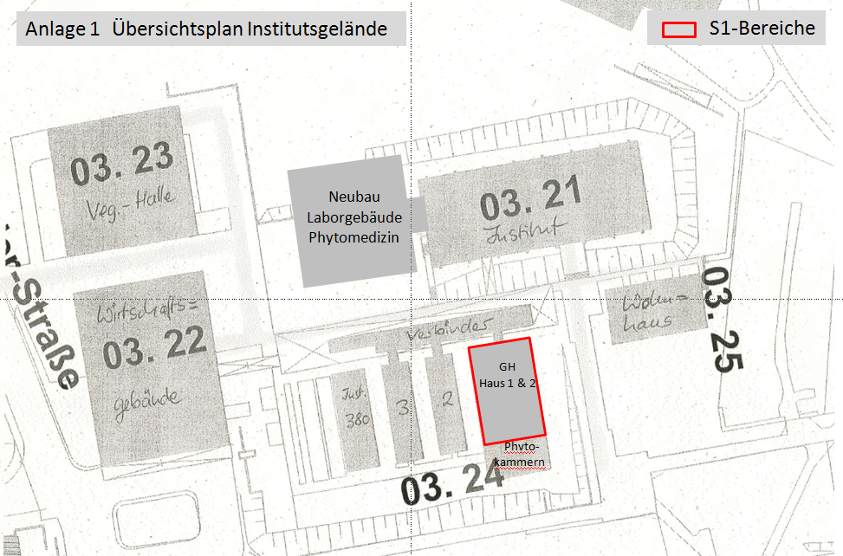
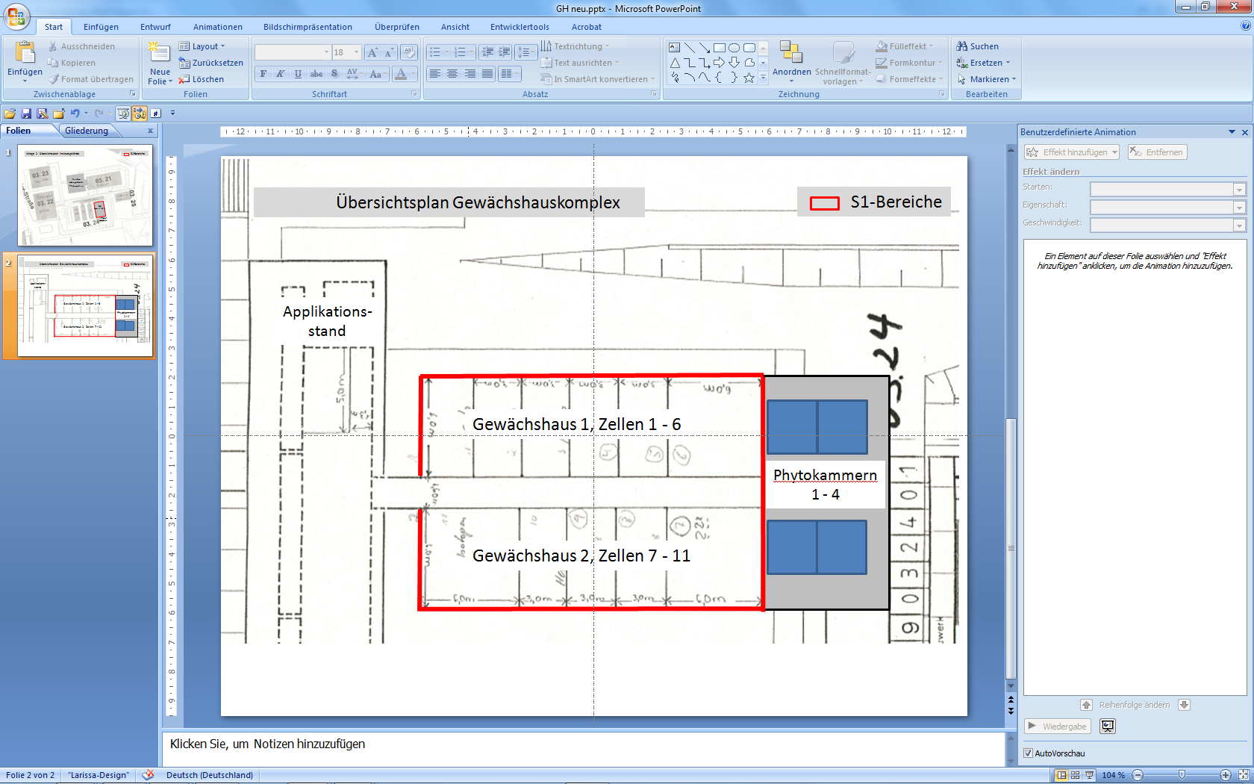
Greenhouse S1 area includes House 1, and House 2

Slide 5
Working with Genetically Modified Organisms
(GMOs)
Hazard potential of the organisms handled
According to the criteria listed, all genetic engineering work carried out in the laboratories of the Institute of Phytomedicine, Otto-Sander-Str. 5, is classified as risk group 1 under the Genetic Engineering Act.
The primary escape route is the stairwell.
Secondary escape route: via the laboratory balconies on the west side, or at the end of the newly attached LKP building.
No emergency power supply is available.
Keep windows and doors closed while working.
Wear lab coat, closed shoes, long pants and safety goggles in designated areas.
Eating, drinking and storing food is prohibited in all areas, including the “thinking cells.”
Do not pipette by mouth.
Avoid using sharp or pointed objects whenever possible.
Keep laboratory spaces tidy and clean:
Only keep the equipment and materials on the workbench that are actually needed.
Store supplies in storage rooms or cabinets whenever possible.

Slide 6
Working with GMOs
Good microbiological practices must be followed at all times.
Avoid aerosol formation.
Contaminated areas must be disinfected immediately.
Equipment that has come into direct contact with GMOs must be autoclaved or disinfected before cleaning
After completing work and before leaving the laboratory, wash hands.
Genetic engineering work is only permitted at designated workstations (washable surfaces resistant to disinfectants, e.g., stoneware or melamine).
Strict separation of work and writing areas must be maintained.
GMOs, including contaminated waste, may only be transported in break-proof, closed containers.
Appropriate records of the genetic engineering work performed must be maintained.
Proper documentation of all genetic engineering activities is required

Slide 7
Guidelines for Handling Transgenic Plants
All transgenic plants or plants containing transgenic microorganisms must be clearly labeled as such.
The occupancy plan on the entrance door of the greenhouse cabin must indicate the name of the person responsible for the experiment.
Transgenic plants may only be transported between greenhouse cabins.
Transgenic plants or plant parts may be transported to other S1 areas only with care to prevent loss of material. Use boxes or plastic bags as appropriate.
The transport container must be appropriately labeled.
If possible, bag flowers at the bud stage or remove pollen-producing parts.
Ensure that no dying or mature parts, particularly seeds, fall from transgenic plants.
Seeds from transgenic plants may be stored in a sealed container in the institute’s S1 laboratories. They must be clearly labeled.

Slide 8
Disposal of Genetically Engineered Waste
After completing work, GMOs must either be properly stored or inactivated by autoclaving.
All waste contaminated with GMOs (disposable vessels, gloves, wipes, etc.) must be autoclaved before disposal (autoclaves available in Room 082). Follow the operating instructions when using the autoclaves.
Transgenic plants or plant parts must be shredded, placed in autoclave bags, and autoclaved in Room 082. Fully inactivated plant material can then be composted. Plants with potential pollen transfer from transgenic plants must be treated and disposed of in the same way.
Used soil must either be steamed for twelve hours in the greenhouse in consultation with the head gardener or autoclaved in small quantities. After inactivation, soil is composted like the plant material.

Slide 9
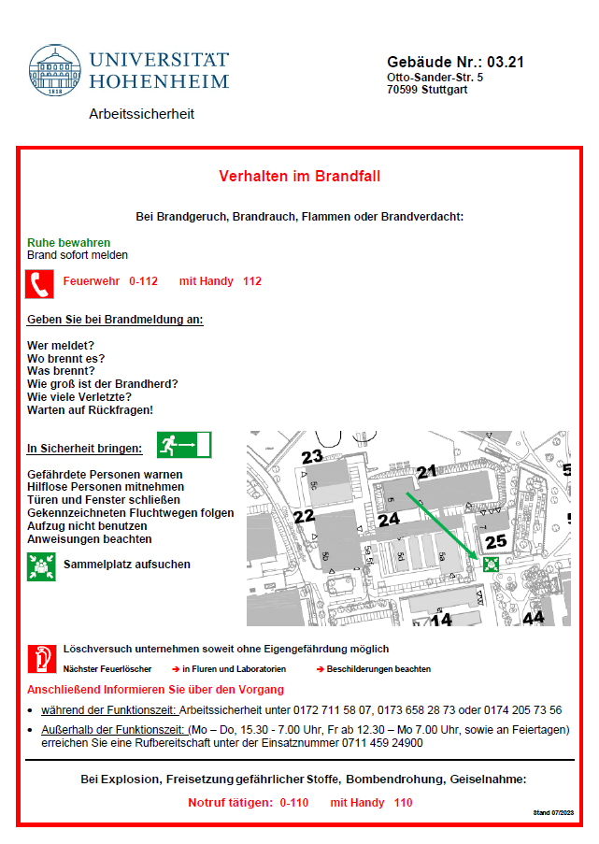
What to do in an emergency or fire
Call the emergency number:
From a mobile phone: 112
From office or laboratory phones: 0-112
Speak slowly, clearly, and loudly, providing the following information:
Who is reporting?
What has happened?
Where did it happen?
Provide precise location details: street, house number, fire plan number: 5/336
How many people are injured?
What type of injuries are present?
- Stay on the line and wait for further instructions
Assembly point
corner towards cemetery
In case of fire:
- Leave the building immediately.
- Assist other persons if possible.
- Call emergency services
Who, What, Where.

Slide 10
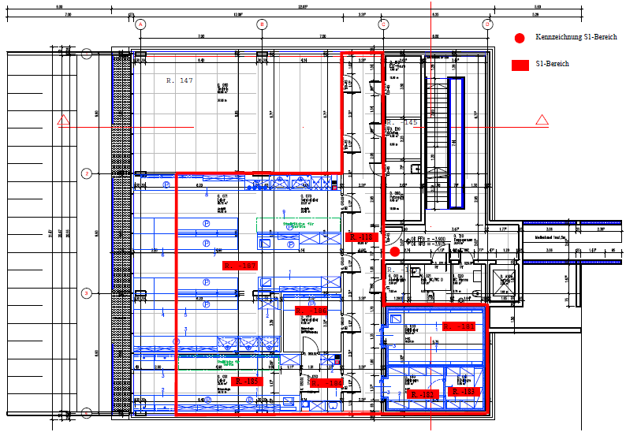

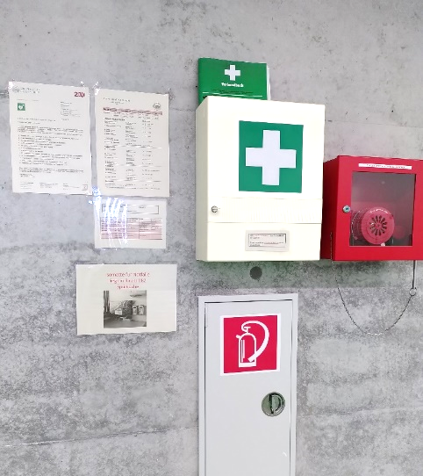
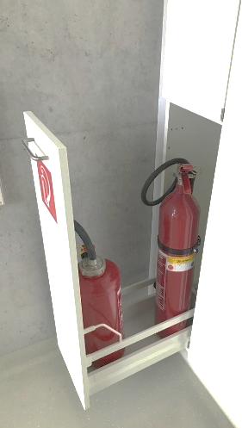
Handling Accidents with S1 Organisms
Stay calm and immediately inform the lab manager.
Disinfect contaminated areas and materials immediately.
Autoclave or dispose of contaminated items as GMO waste.
Rinse affected skin or eyes thoroughly using the safety shower or eye wash station.
First aid supplies are available in first aid boxes in the corridors on every floor.
Fire extinguishers are located in corridors or at the entrances to the laboratories.
Report and document all incidents according to the institute’s safety guidelines.
first aid logbook
Emergency numbers

Slide 11
Records of Genetic Engineering Work – Organization and Content
Documentation requirement!
The documentation consists of three parts
General information on the project / facility (Part I)
Vector- and organism-specific information (Part II)
Details of the genetic engineering experiment (Part III)
The collection and maintenance of records are delegated to the respective group leaders.

Slide 12
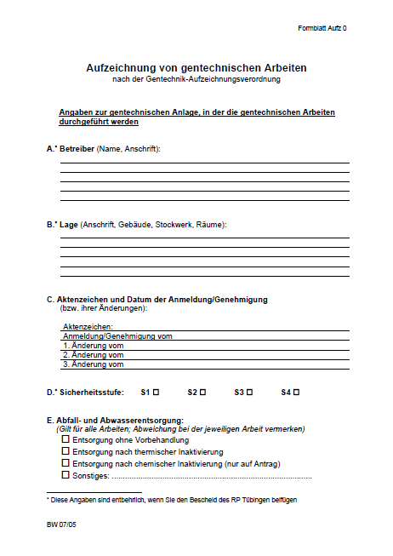
General information on the project / facility
Part I

Slide 13
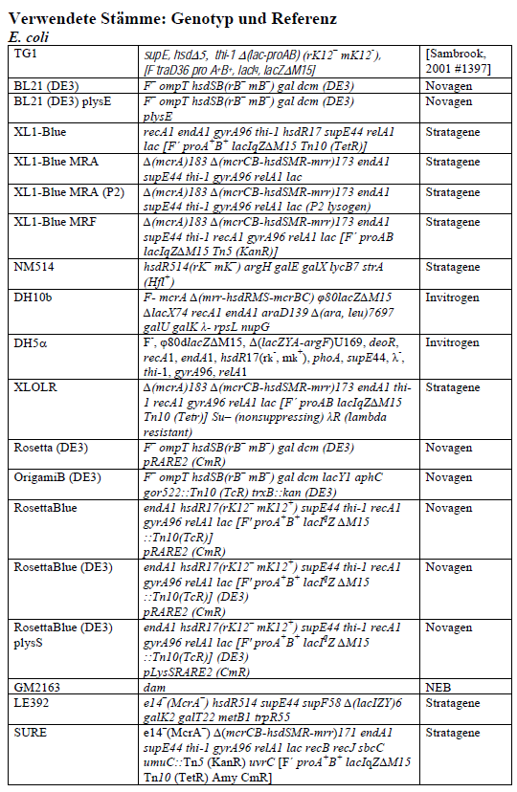
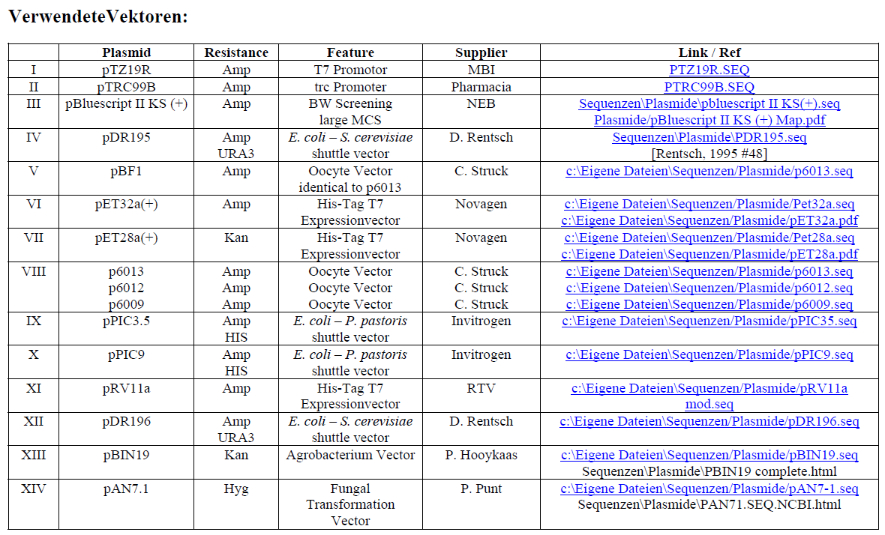
Vector- and organism-specific information
Part II

Slide 14
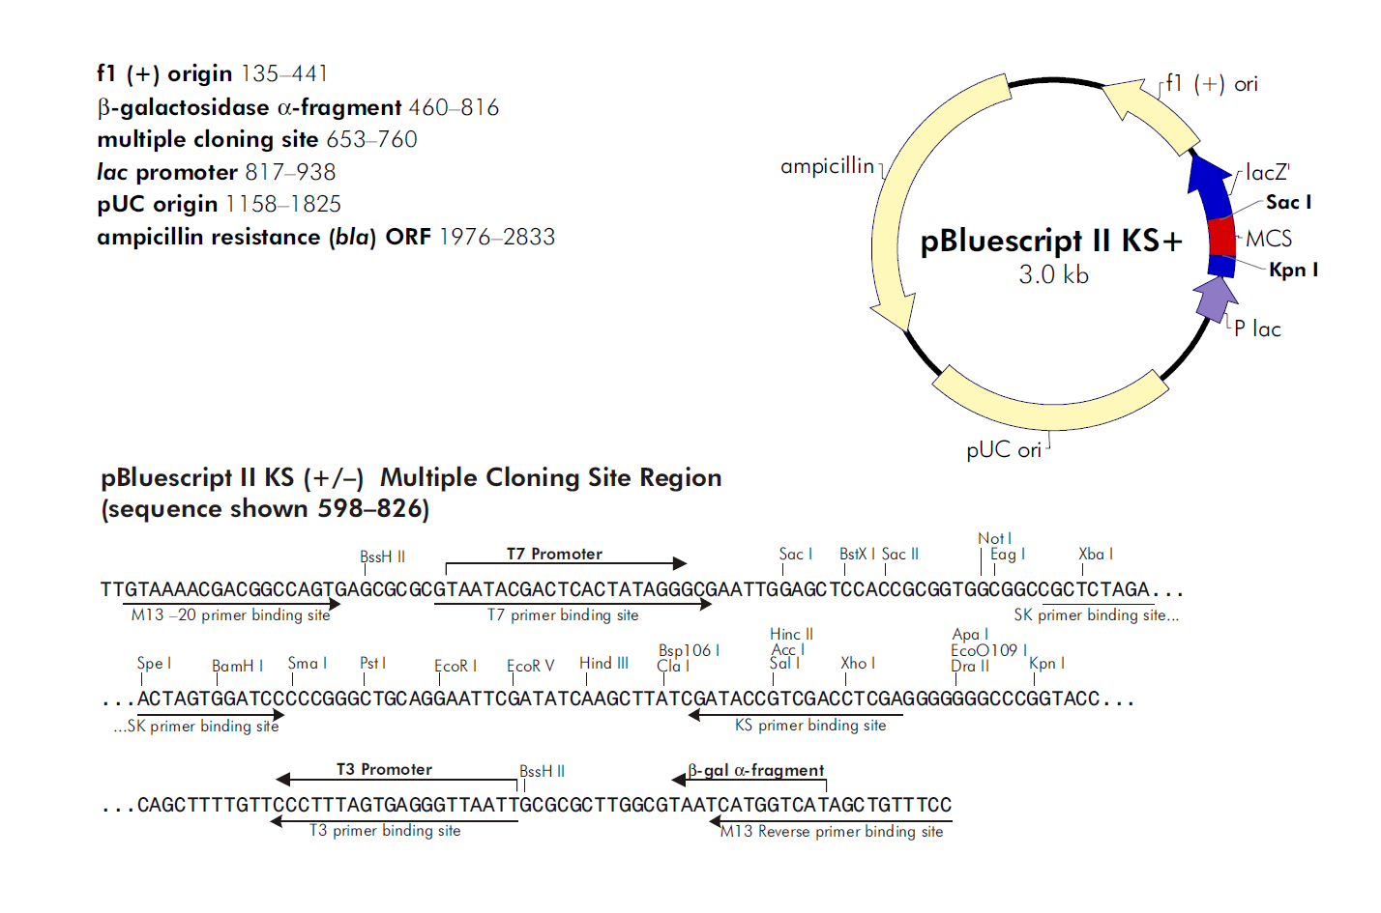
Vector- and organism-specific information
Part II

Slide 15
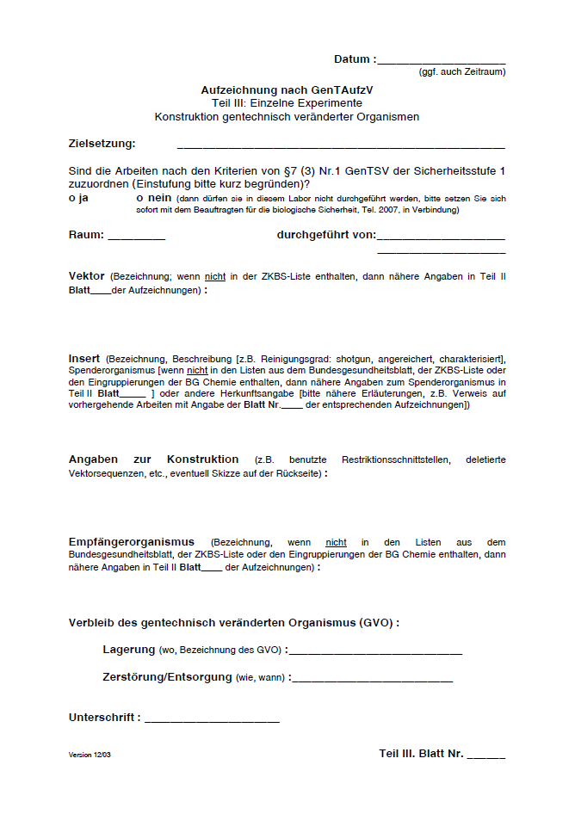
Details of the genetic engineering experiment
Part III

Slide 16
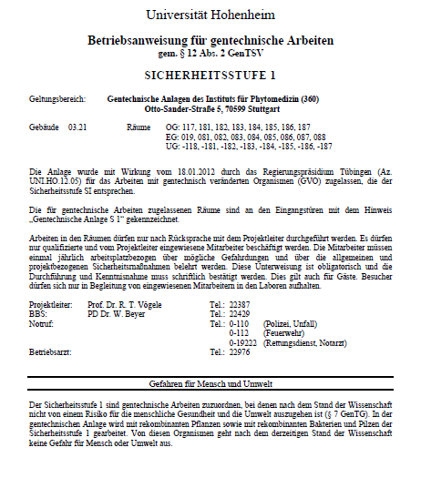
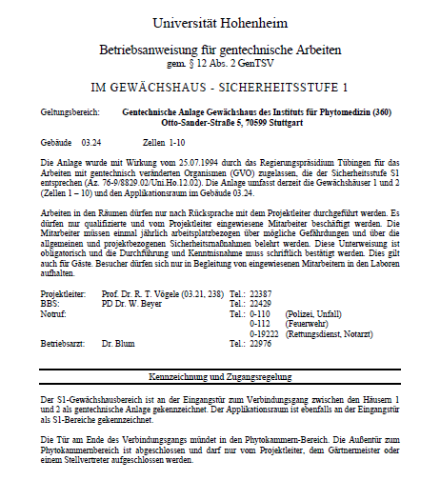
Operating Instructions
The operating instructions for genetic engineering work in accordance with §12 (2) GenTSV are displayed at the designated locations. In the main building, they are posted in the corridor areas leading to the laboratories on all floors. In the greenhouse, the operating instructions are displayed at the entrances to House 1 and House 2.
The green dot in the graphic indicates where the operating instructions are posted.

Slide 17
General Safety Instruction Institute of Phytomedicine (360)
Overview
A. Laboratory Access
B. Safety Regulations and Instructions
C. Accident Prevention
D: Substitution of CMR Substances
E. Emergency Procedures
17

Slide 18
A-1. Laboratory Access
Access permitted only to employees, students, and trainees who have completed the safety instruction.
Entry only during working hours.
No visitors allowed – see exception regulations.
For exceptions, consult the group manager
18

Slide 19
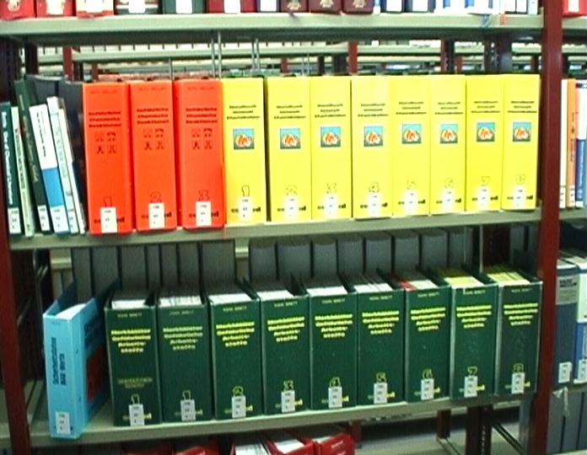
B-1. Safety Regulations
19

Slide 20
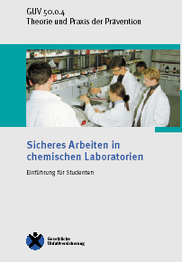
B-2. Safety Regulations
A completed safety instruction, including documentation and signature of the instructed person, is an absolute prerequisite before starting any laboratory work.
This safety instruction is performed within each department by the designated responsible persons.
Basis of the instruction includes
Laboratory Guidline GUV - R 120
Safe Working Practices GUV - I 8553
20

Slide 21
B-3. Safety Regulations
In the Laboratory
Safety glasses, lab coats (cotton), and closed shoes are mandatory personal protective equipment (PPE).
Eating, drinking, and smoking are strictly prohibited.
Working alone is not permitted (especially on weekends).
Before starting any laboratory work, general and, if applicable, specific safety instructions must be completed.
21

Slide 22
C-1. Accident Prevention
Measurement procedures on machines or chemical reactions (e.g., drying in an oven) must always be supervised and monitored.
Chemical containers with prepared solutions must be clearly and correctly labeled.
Maintain cleanliness and report any damage promptly.
Spilled materials must be safely absorbed and removed using absorbent pads.
Transport chemicals and materials using buckets or carts with side walls.
Secure gas cylinders with chains or store them in approved safety cabinets.
Ensure proper waste disposal in designated containers and use resources sparingly.
22

Slide 23
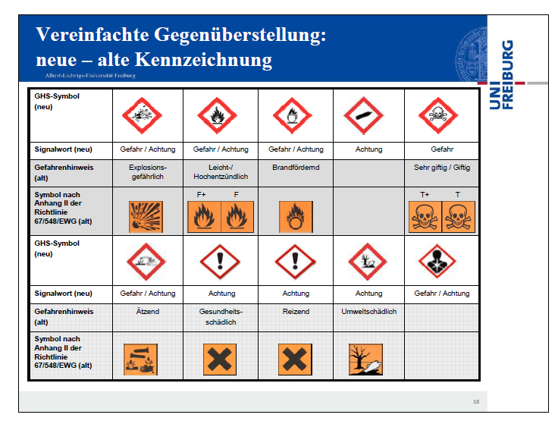
C-2. Accident Prevention
Simplified Overview: New (neu) and Former (alt) GHS Labeling Symbols
23

Slide 24



D-1. Handling and Substitution of CMR Substances (Carcinogenic, Mutagenic, or Reprotoxic Substances)
What are CMR Substances and Why Must They Be Substituted? CMR substances are carcinogenic (C), mutagenic (M), or toxic to reproduction (R). They pose a particularly high risk to human health.
Employer Obligations (§ 7 German Hazardous Substances Ordinance – GefStoffV):
Under the Hazardous Substances Ordinance (GefStoffV), there is a clear obligation to substitute such substances wherever technically feasible.
This means hazardous substances must be replaced by less hazardous substances or processes.
For CMR substances, this substitution requirement is especially strict, as they are classified as particularly hazardous substances — specifically categories 1A and 1B under the regulation.

Slide 25
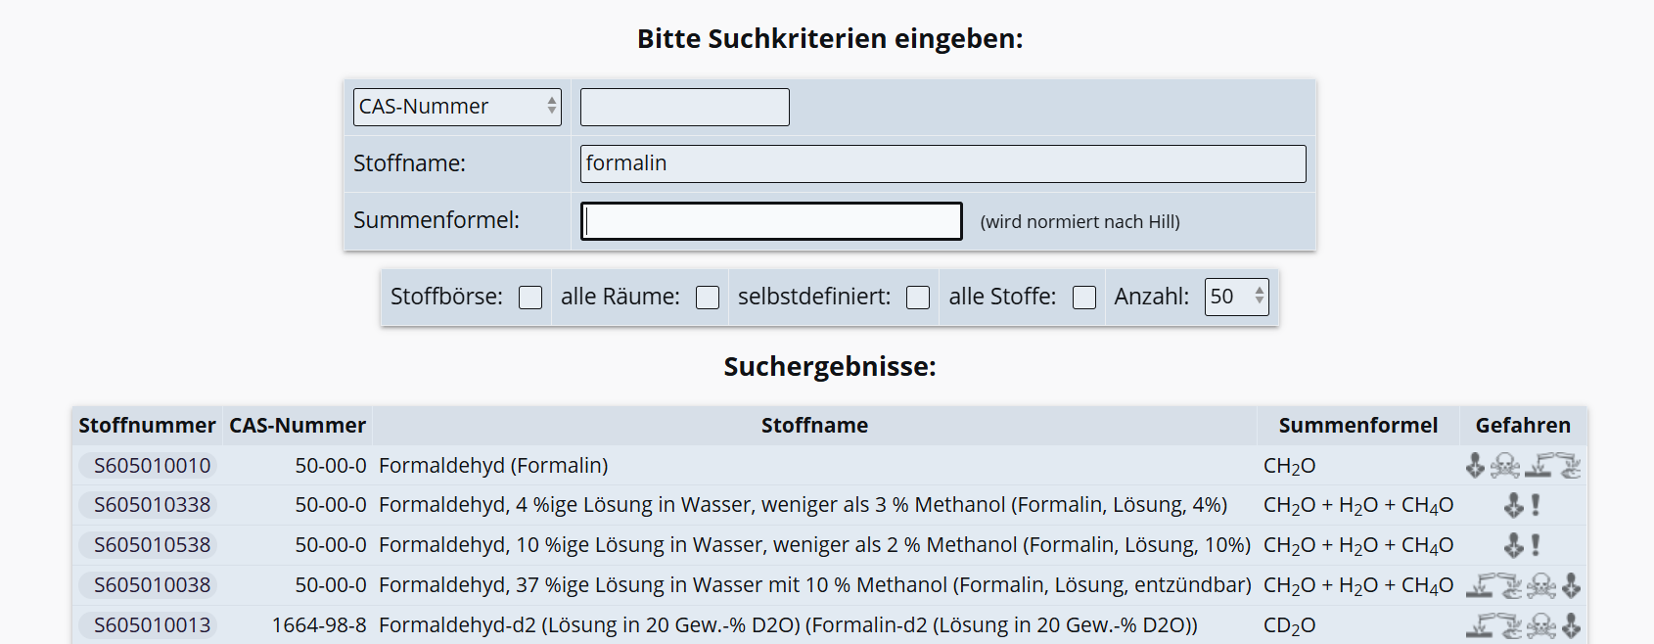
D-2. Identification of CMR Substances
CMR substances are identified using the university-wide Chemical Inventory System (DaMaRIS – Dangerous Materials Registry Information System).
At Institute 360, access to DaMaRIS is provided through the designated Safety coordinator
Regular Updates: The chemical inventory – DaMaRIS – must be reviewed and updated at least once per year to ensure accuracy and compliance.
Search Procedures for CMR Substances:
A specific evaluation of an individual chemical (e.g., formalin) can be performed.
Alternatively, a comprehensive database search can be conducted using the CMR template to identify all relevant substances.
DaMaRIS - data entry form

Slide 26
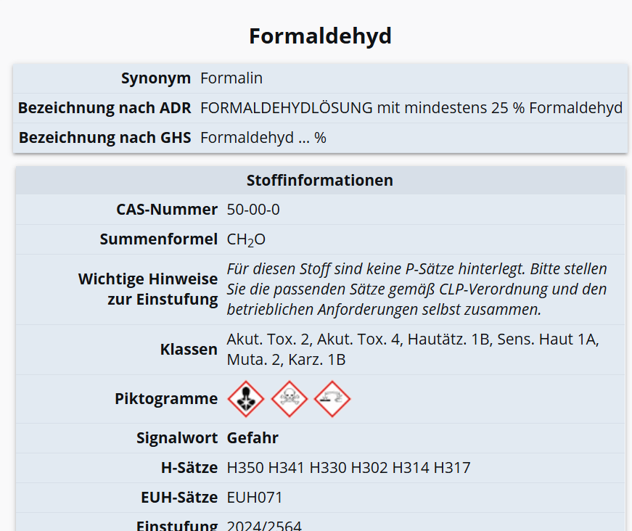
D-3. Substitution Process Formaldehyde
Information Gathering: Information on a specific CMR substance is obtained by entering the substance into the chemical registry, in this case DaMaRIS (Dangerous Materials Registry Information System).

Slide 27
D-4. Substitution Process Formaldehyde
Evaluate Substance-Specific Risk Assessment:
Examine Work Procedures: Review how formaldehyde is originally used in the workflow.
Information Search for Substitution Options:
TRGS 600 / 900 on replacement substances
Safety Data Sheets (SDS)
DaMaRIS chemical registry
Preselection of Potential Alternatives:
Evaluate alternative substances in terms of feasibility and compatibility with existing work procedures.
Key Selection Criteria for Replacement Substances:
Health Hazards
Physical and Chemical Risks (e.g., potential for release, fire, explosion)
Technical Suitability for your process and workflow
Environmental Aspects

Slide 28
D-5. Handling of CMR Substances
Protection of Health and Life
CMR substances can cause serious health damage even in small quantities and must therefore be substituted or minimized whenever possible. This reduces exposure for employees, students, the environment, and third parties.
Employers (or supervisors acting on their behalf) are obligated under § 5 of the Occupational Health and Safety Act (ArbSchG) to conduct individual risk assessments for all CMR substances used.
In addition, it must be thoroughly documented why substitution was not possible.
The documentation must include:
- The individual risk assessment for the CMR substance intended for substitution
- The work procedures involving the respective CMR substances
- Comprehensive research on possible alternative substances or methods, including justification for why substitution is not feasible in this specific case
The legal and technical basis for the minimization requirement is defined in the following essential Technical Rules for Hazardous Substances (TRGS):
TRGS 400 – Risk Assessment
TRGS 500 – Protective Measures
TRGS 600 – Substitution

Slide 29
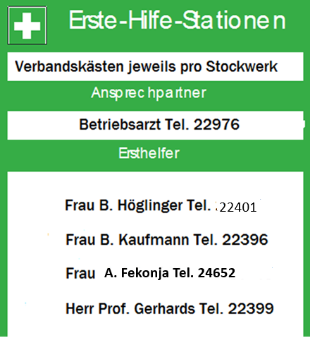
E-1. Emergency Procedures
Stay calm:
Identify what has happened
Assess possible dangers
Act accordingly
First Aid Facilities
First aid kits on each floor
Contact person
Actions:
Secure the accident site (e.g., activate the emergency stop)
Move injured persons out of the danger zone only if it is safe to do so
Alert others in the danger area
Provide first aid
Call emergency services: (0)112
First aiders

Slide 30










E-2. Emergency Procedures
Safety facilities
Emergency Exits and Escape Routes
First Aid Room,
Stretcher
First Aid Kits (What to Do)
Assembly Point
Alarm Systems, Telephone
(Emergency Call)
Fire Extinguishers and
Fire Alarms
Emergency Shut-Off for Utilities Gas, Water, Electricity)
☞
Eye Wash Station
Respiratory Masks, Filters
Safety Shower
30

